Slide 1
MULTI SEQUENCE LEARNING (NUMBERS/IMAGE/ ALPHABETS)
Gaurav Honnavara Manjunath - 1384178
Harish Palanivel - 1392283
Athkar Praveen Prajwal - 1394663

Slide 2
OBJECTIVE
The primary objective of this project is to examine the HTM prediction Engine and understand Multi sequence Learning for the Sequence of Numbers.
By using Multi sequence Learning as a reference model, Multi sequence Learning for a Sequence of Alphabets and Image Data sets needs to be developed, including the training and prediction phase and configuring HTM parameters for improving accuracy

Slide 3
TABLE OF CONTENTS
INTRODUCTION
IMPLEMENTATION (LEARNING & PREDICTION PHASE)
METHODOLOGY
ENCODING
WORKING OF SPATIAL POOLER
RESULTS
CONCLUSION

Slide 4
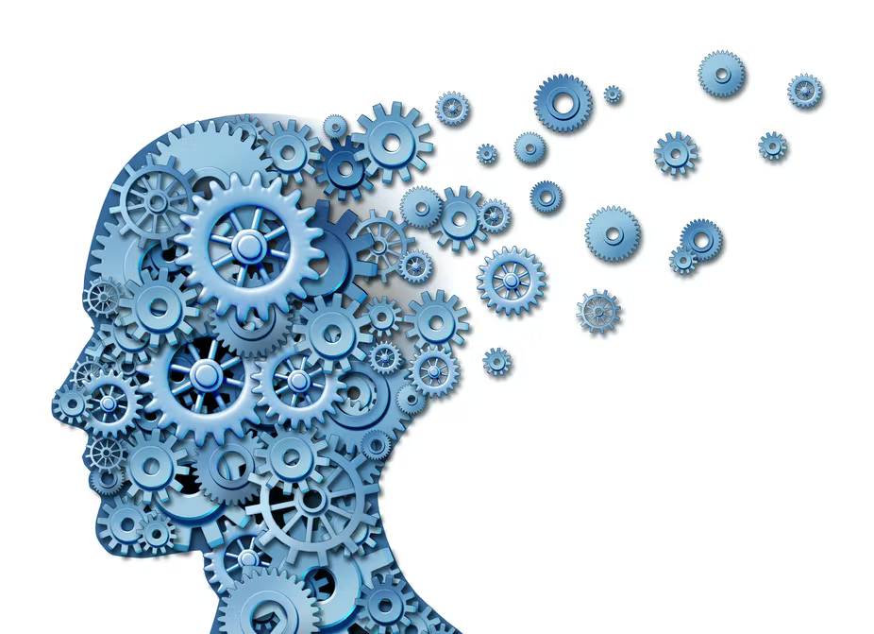
INTRODUCTION
Medical Science and ML engineers were working on the understanding of cortex for temporal pattern recognition.
HTM (Hierarchical Temporal Memory) has been proposed for sequence learning.
HTM is a biomimetics model based on the principle of memory predictions

Slide 5
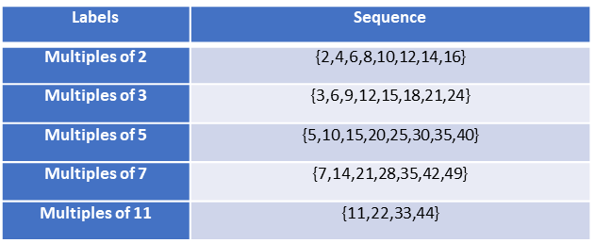
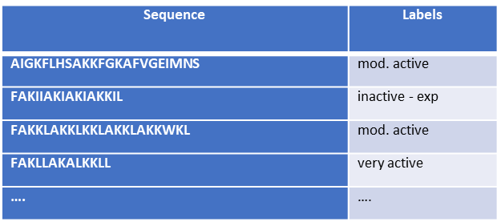
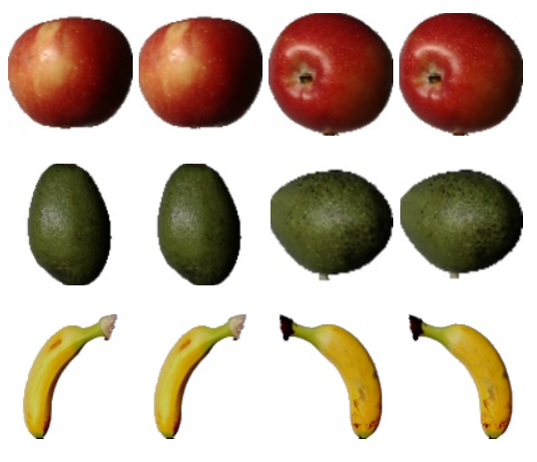
METHODOLOGY - DATASETS
NUMBERS
ALPHABETS
IMAGE

Slide 6

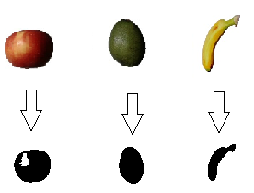
ENCODING
Numbers and Alphabets use Scalar encoder
Images use HTM Image encoder
Encoded Data row
Binarized Image

Slide 7
WORKING OF SPATIAL POOLER
Creates SDR Input
Columns that are not active is not learnt
Each pattern that is appeared as input is compared with the database
Spatial Pooler
Temporal Memory
Classifier

Slide 8

IMPLEMENTATION (LEARNING & PREDICTION PHASE)
For Numbers and Alphabets
Fetches datasets and train using Spatial Pooler by using scalar encoder
Homeostatic Plasticity Controller is used for Stability
Spatial Pooler trains each sequence for several iterations until it reaches stable state
For Image
The datasets are fetched as .jpg file and is binarized using Encoder
Homeostatic Plasticity Controller is used for Stability
Spatial Pooler is used to train the binarized datasets for several iterations until spatial pooler reaches stable state

Slide 9
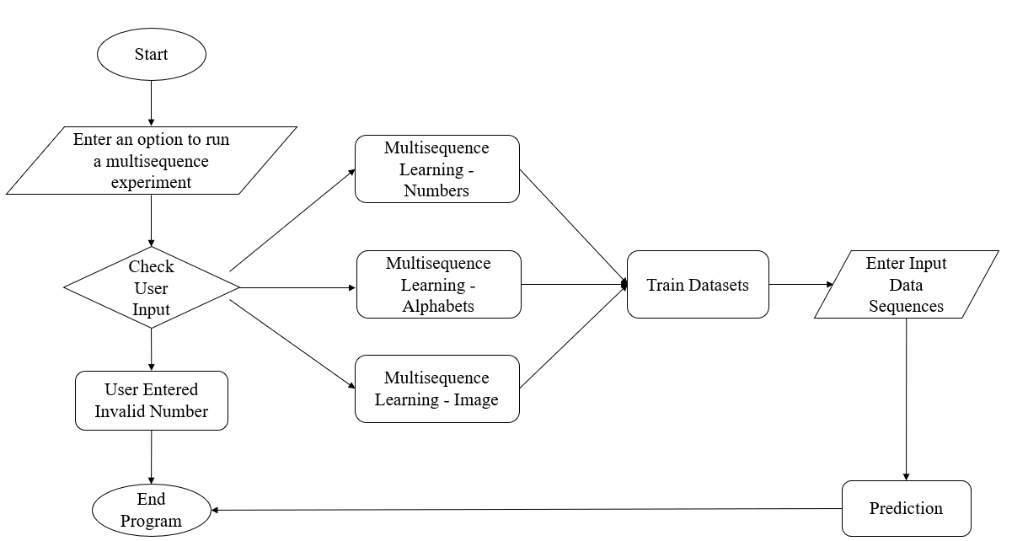
FLOW CHART
This flow chart explains about how the multisequence learning is implemented

Slide 10
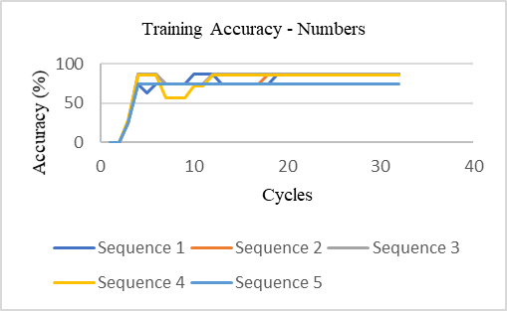
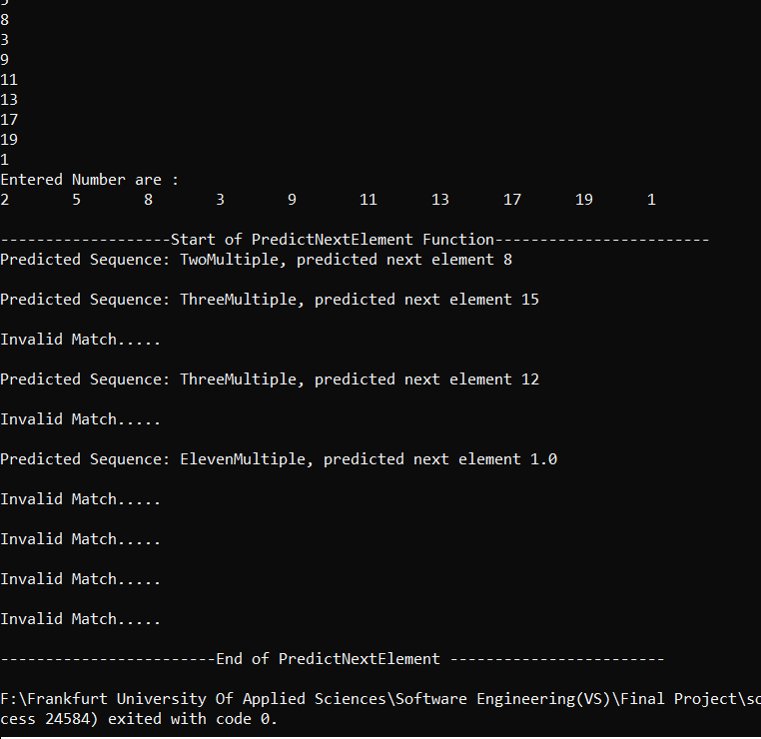
RESULTS - NUMBERS
The graph represents the accuracy for the trained sequence of numbers and figure shows prediction

Slide 11
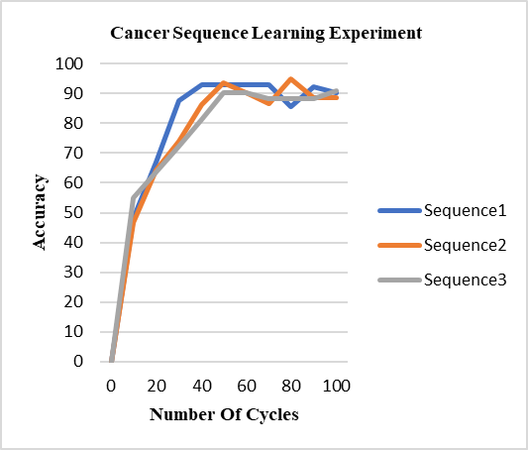
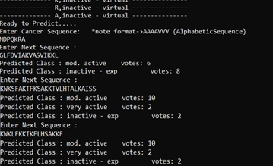
RESULTS - ALPHABETS
The graph represents the accuracy for the trained sequences of alphabets and figure shows prediction

Slide 12
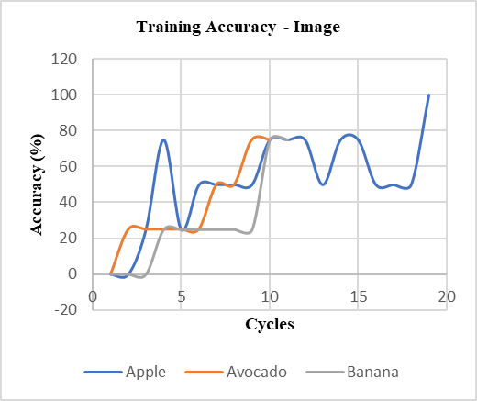
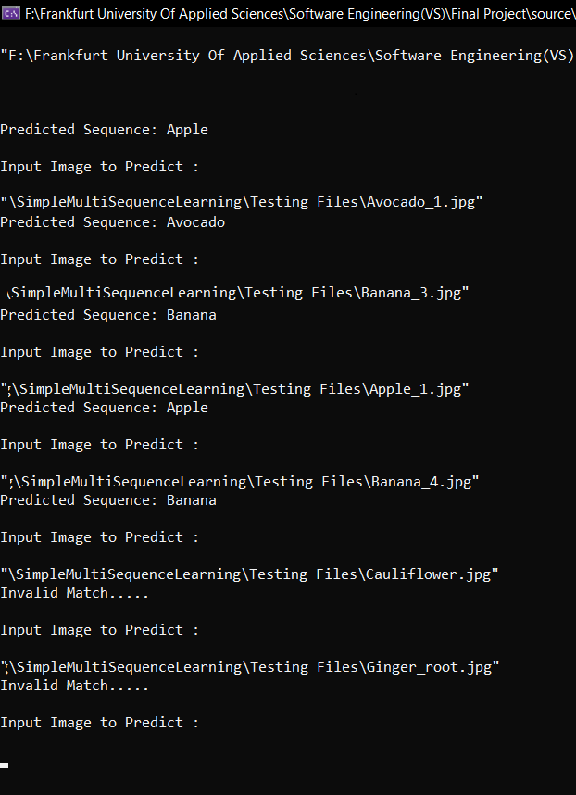
RESULTS - IMAGES
The graph represents the accuracy for the trained series of Images and figure shows prediction

Slide 13
CONCLUSION
In this project, the implementation was on different types of input data sets like numbers, alphabets and images. These input datasets are encoded using scalar encoder and Image encoder to store respective trained datasets.
By using Prediction algorithm, the input that is given is predicted by comparing with the trained data sets.
We performed Multi Sequence Learning for a different sequence of data sets and could achieve up to 87.5% of accuracy in the Training Phase.
Additionally the inputs data sets can be modified for any sequence of numbers, alphabets and images as per the requirements to identify their categories

Slide 14
REFERENCES
Keele, "“Sequence learning,” - B. A. C. G. J. D. S. W.," 1998. [Online]. Available: https://pubmed.ncbi.nlm.nih.gov/21227209
"D. V. B. Michael D Mauk, “Sequence learning,”," 2004. [Online]. Available: https://pubmed.ncbi.nlm.nih.gov/15217335
"B. H. J. L. R. .Rabiner, “An introduction to hidden markov models,”," 1986. [Online]. Available: http://ai.stanford.edu/~pabbeel/depth_qual/Rabiner_Juang_hmms.pdf.
Hawkins, "J. C. S. A. J. , “Continuous online sequence learning with an unsupervised neural network model,”," 2016. [Online]. Available: https://pubmed.ncbi.nlm.nih.gov/27626963
S. A. J. Hawkins, "“Why neurons have thousands of synapses, a theory of sequence memory in neocortex,”," 2016. [Online]. Available: https://www.frontiersin.org/articles/10.3389/fncir.2016.00023/full.

Slide 15
THANK YOU TEAM NOOBIES

